Slide 1
Top Level Matrix Workshop

Slide 2
This document contains confidential
and proprietary information owned
by Lean Horizons Consulting, LLC.
Any disclosure, use, copying or
distribution of this information without the express written consent of Lean Horizons Consulting is strictly prohibited.

Slide 3
Ground Rules for Event
Safety first (use personal protective equipment)
Active participation by all
Start and end on time
All electronic gadgets (phones, pagers, etc) turned to “off” or “silent”
Computers to be used only when instructed
Keep an open mind to change
Don’t let “perfect” get in the way of “better”
Notes:
DO: Perform Group Introductions. Pick an ice-breaker or exercise to warm the team up to the event. (Icebreaker Example: Everyone uses their name tent and writes a “Personal License Plate” in which they have 2 minutes to creatively use a total of 7 letters or numbers to tell us something about themselves. Examples “LV2SAIL” OR “DADOV5”
DO: Review Event Ground Rules.
ASK: “Does anyone have any rules they would like to see added?”
ASK: “Does everyone agree to these?”

Slide 4
Communication Process
Compliance
Debate
Discussion
Dialogue
Do as asked or told
Typically one-way communication—
no discussion required except for questions about clarity of direction
Influence through position of power
A structured argument—
purpose is to win argument
Winning is achieved by showing the merit of a position and the denigration of the opponent’s position
Influence through a win/lose equation
A civil discourse
Exchange of information and positions on topics
Positions may be influenced but are typically held based on expertise or role
A discourse guided by a spirit of inquiry
Communication purpose is to understand how we think and the assumptions we hold about a topic
Communication serves to make explicit the “tacit knowledge” in a group
Notes:
Typically, teams communicate via debate – we want them to think differently about how they interact with their teammates.
Stress that this is about exchange of ideas, new ways of thinking, and a spirit of inquiry.
Facilitator: Check to make sure the leader in the room isn’t giving off the “vibe” of compliance.

Slide 5
Strategic Deployment is the way to run the business
Overview of Strategic Deployment
Components of Top Level Matrix
Creating the Top Level Matrix
Reflection
Goal of Strategic Deployment:
Focus resources on the vital few business imperatives, and manage for predictable operational and financial success
Notes:
DO: State the overall goal for Strategic Deployment.
SAY: “Our goal for this Client-Leader Workshop is to provide an overview of the Strategic Deployment Process and
prepare leadership with the expectations of how to lead with Strategic Deployment. We will do this through an overview of the SD process, an interactive workshop that develops your SD architecture, a discussion of the SD leadership requirements, and finally to complete the workshop deliverable, which we will detail in just a few moments.”

Slide 6
Overview of Strategic Deployment
Overview of Strategic Deployment
Components of Top Level Matrix
Creating the Top Level Matrix
Reflection
Objectives:
To define Strategic Deployment
To identify the Japanese origins of Strategic Deployment
To identify the significance of Strategic Deployment to a Lean business system
To define Strategic Deployment Implementation Methodology
To define Strategic Deployment Deliverable
To review Strategic Deployment Success Stories
Notes:
DO: Review section objectives on slide.

Slide 7



Develop Strategy
Overview of Strategic Deployment
When building a house, which would you do first?
Hire an Architect? – Strategic Plan
Hire a General Contractor? – Strategic Deployment Process
Hire Skilled Tradesmen? – Value Stream Mapping and Kaizen (Continuous Improvement)
Strategy Deployment turns your Strategy into reality!
Notes:
DO: Use this analogy and stress the common error that many companies make during Strategic Deployment.

Slide 8
Why is it so difficult to implement strategy?
Overview of Strategic Deployment
Percentage of people who understand the strategy
Source: CFO Magazine
Notes:
DO: Ask the participants whether they understand the difference between a vision, mission and strategy. Describe the differences to level-set everyone’s understanding.
NOTE: Definitions:
Vision: Where are we going? What do we want to become? Example: To become the premier, #1 supplier of electronic automotive components in the USA and eventually the world.
Mission: What do we do? Where (markets) do we play? How will we win? Example: We will leverage our unique product development and operational capabilities in the automotive OEM and aftermarket.
Strategy: A detailed plan of how we will accomplish the Vision and Mission…how we will win in the marketplace.

Slide 9
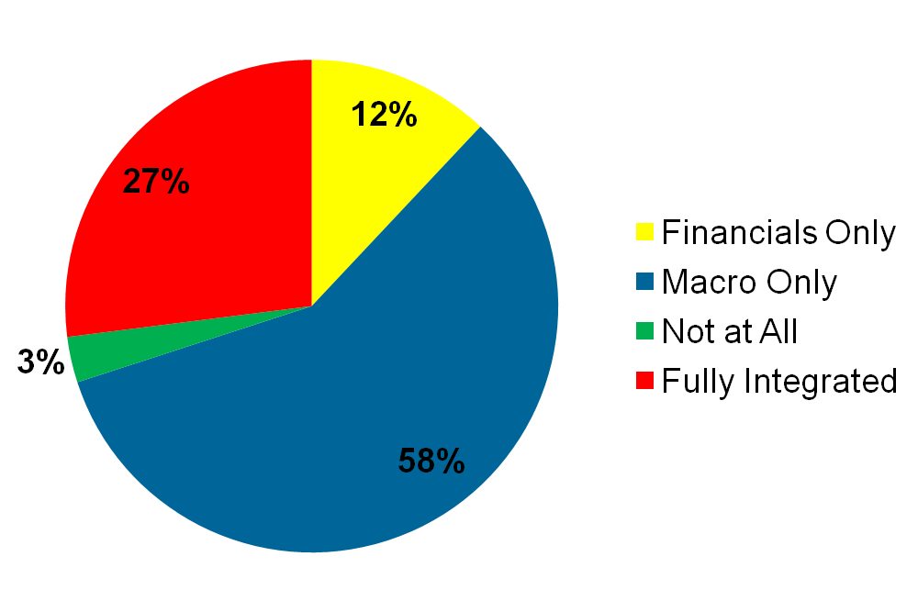
Develop Strategy – The Missing Link
Overview of Strategic Deployment
Only 27% of Companies Integrate Strategy with Tactics.
Source: Hackett, Benchmarking Solutions
Notes:
DO: Express your own experience with implementing strategy. Any war stories?
ASK: “What are examples of a “Macro” strategy.” An example: One company had a strategy of “Seize the End User”. This is NOT a strategy and it is difficult to implement. It may mean different things to different people.
NOTE: Many companies think that their budgets are their strategy. Discuss why this is not so.

Slide 10
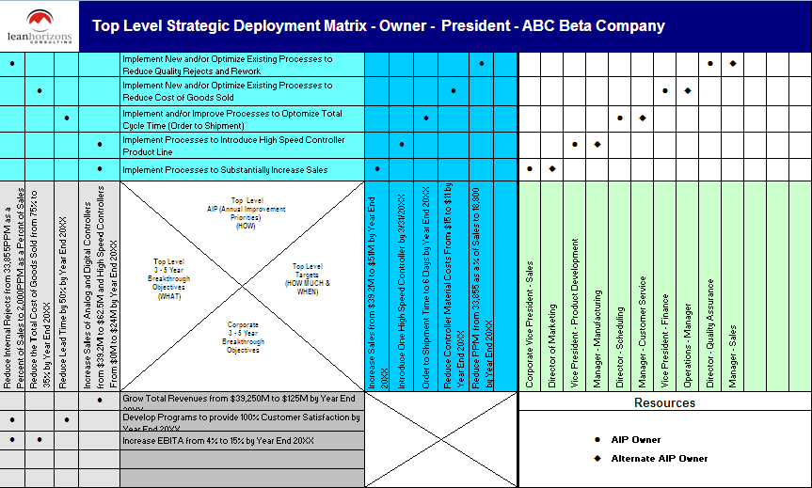
Strategic Deployment is a planning and implementation process
Overview of Strategic Deployment
Strategic Deployment
SD Planning
Focuses on the implementation of Breakthrough Objectives
Links Breakthrough Objectives with specific Resources
Aligns Resources within the company
SD Implementation
Facilitates ongoing review of progress (PDCA)
Results in specific Action Plans and Measurements
Is always a dynamic process
Strategic Deployment fosters management to work ON the business not IN the business.
Notes:
SAY: “You see the word, “breakthrough” appear several times here. Let’s talk about breakthrough objectives.
A Breakthrough Objective aligns with a business’ strategic imperatives
Breakthrough Objectives represent a significant performance improvement
Breakthrough Objectives require the organization to stretch itself to reach sustainable levels of performance never attained before.
Breakthrough Objectives typically target a 1-3 Year timeframe
SD is always a dynamic process: changes when necessary.”

Slide 11
Strategic Deployment converts strategic imperatives into reality.
Overview of Strategic Deployment
Will force the clear identification of how we move towards Breakthrough Objectives |  | Will not achieve results if the management process isn’t changed (move to rigorous PDCA)
Will create alignment of all facets of the organization on the key strategic initiatives |  | Will not achieve results if the “hows” aren’t the right ones
Will foster a data-oriented, fact-based culture |  | Will not achieve results if the “hows” aren’t clearly defined
Will reinforce the vision, and clearly define how we get there |  | Will not replace business fundamental responsibilities
Notes:
DO: Cover points on slide as to what SD will and will not do.

Slide 12
Benefits of Strategic Deployment
Overview of Strategic Deployment
Reduces the speed-to-value cycle by aligning Lean strategy to Resources
Forces an organization to focus on the critical few strategic imperatives
Ensures standardized, sustainable, high-performing business processes
Ensures sustained breakthrough results
Provides a means towards strategic competitive advantage
Provides a means to communicate the strategic vision
Notes:
SAY: “Strategic Deployment:
Reduces the speed-to-value cycle by aligning Lean strategy to resources – Everyone focused on waste
Forces an organization to focus on the critical few strategic imperatives
Facilitates consensus and buy-in as to the direction of the organization through cross-functional participation
Ensures standardized, sustainable, high-performing business processes
Ensures sustained breakthrough results
Provides a means towards strategic competitive advantage
Superior:
Customer Satisfaction
Financial Performance
Enterprise Valuation
Provides a means to communicate the strategic vision of the organization”

Slide 13
Hoshin Kanri: Strategic Deployment Foundation
Overview of Strategic Deployment
Control of the Organization’s Direction
Hoshin
Kanri
Compass For Direction
Management Control
Provides a robust framework for management to control growth
Directs executives to deploy resources to the activities most capable of removing waste
Creates a “drumbeat” of waste elimination across the business
Notes:
SAY: “Hoshin Kanri or Hoshin Planning is the Japanese name for Strategy Deployment. Tell the class that this has it’s roots at Toyota and is an integral component to an successful Lean transformation.”

Slide 14
Strategic Deployment tie to a Lean Business System
Overview of Strategic Deployment
Develop Strategic
Business Imperatives
Develop Strategic
Breakthrough Objectives
PDCA
Deploy Strategic
Breakthrough Objectives
PDCA
Identify Strategic
Value Streams
and Initiatives
PDCA
Targeted Kaikaku
And Kaizen (Continuous
Improvement) Activity
PDCA
Notes:
SAY: “Key point is that Strategic Deployment is an iterative process, and that the appropriate lean tools should be selected in order to achieve the stated business objectives.”
DO: Emphasize “Breakthrough”, “Breakdown”, and “Deselection”
→ FOCUS
NOTE: Definitions:
Value Stream - Is a snapshot of all actions both value added and non-value added required to bring a product or service through the main material and information flows
Kaizen (ki-zen’)– Literally “good change” or “improvement
A closer definition to the Japanese usage of kaizen is “to take it apart and put back together a better way
What is taken apart is usually a process, system, product, or service
Kaikaku – (ki-ka’-ku) Breakthrough improvement

Slide 15
From Strategic Deployment to Kaizen
Overview of Strategic Deployment
Strategy
Case Study: OEM Manufacturer
Strategy: Achieve Market Share Objectives by becoming counter-cyclical
3-Year Breakthrough: Penetrate the Asian Marketplace to achieve $X of revenue
AIP: Improve New Product Development Process achieving time-to-market improvement from 72 months to 18 months
Value Stream Focus: Engine Lab Lead Time
Kaizen: Reduce changeover on test engine from 3 weeks to 1 day; Tool: SMED
3-Year Breakthrough
Objective
Annual Improvement
Priority/Target
Value Stream Focus
Specific Kaizen
(Continuous Improvement)
Notes:
DO: State how this case study maps back to the model.
This example highlights the key elements of Strategic Deployment:
Strategy
Strategic Breakthrough Objectives
Annual Improvement Priorities
Targets
In this example, one of the most critical value streams in New Product Development was determined to be the Engine Lab Testing. Within that value stream changeover time was identified as waste and thus attacked. Notice the Pareto chart thinking to ‘drill down’ into the opportunity. Also notice how Lean approaches can be linked with changing ‘how’ we run our business.
Important to note here is that the Lean tool (SMED) was chosen AFTER the business objectives were determined. Lean tools should not be implemented without a business purpose. Also stress that SD can help us understand which value streams are strategic. Not all value streams should receive the same time and attention due to their strategic significance to the organization.
DO: Ask the participants if they can also provide a case study/example within their own organizations?

Slide 16

7 Phases of the Strategy Deployment Process
Based on the Deming Cycle - PDCA
Overview of Strategic Deployment
Develop Strategy
Plan
Develop Breakthrough Objectives
Catchball
Do
Check
Act
Develop AIPs, Targets, Resources
Deploy AIPs
Targeted
CI Efforts
Counter-
measures
Implement AIPs
Monthly PDCA Review
Annual Review
QUESTION: Where could be the failure point in your organization?
Notes:
DO: BREIFLY walk the group through this chart noting that you will be taking them through each step in the process in great detail. Key points to stress:
Strategic Deployment is a PROCESS.
The SD process is mirrored after the PDCA cycle.
You must do ALL of the steps to be successful.
Most companies fail by not implementing steps 5 & 6.
Just because you “Planned” does not mean you did SD.
Note the considerable amount of steps in “Plan” vs. other steps. This is typically a Japanese philosophy where they will spend more time in Planning and a small amount of time in the execution (DO) stage. This is sometimes the opposite thinking of traditional Western management.
SAY: “This cycle is based on the Deming Cycle, or the Plan-Do-Check-Act cycle. When leading with Strategic Deployment your business and its processes will continuously be at different points of implementing this cycle. Notice that it is a cycle (and there are cycles within the cycle) because continuous improvement never ends.

Slide 17
Strategic Deployment Roadmap
Overview of Strategic Deployment
TASK 1
TASK 2
TASK 3
Leadership
Workshop
Develop
Top Level
Matrix
Develop Second
Level
Matrices and
complete
Action Planning
Training
TASK 4
TASK 5
TASK 6
Develop
Bowling
Charts
Develop
Countermeasures
Root Cause
Problem Solving
SD Review
Session
Training
Typical Process = 12 Days Over 4 to 6 Weeks
with an additional 4 days of Monthly Review Monitoring
Notes:
DO: Review the steps of implementation for SD. State that you will go into more depth on each one of the steps on the upcoming slides.

Slide 18
Deliverable from Strategic Deployment
Overview of Strategic Deployment
Utilize the
business model and
tools to build the
foundation of a
Strategic Deployment
Translate strategic
objectives
into tangible,
results-oriented
Lean initiatives
Effectively use the
PDCA cycle
when implementing
plans to realize
objectives
Strategic Deployment is the Way to Run the Business.
Notes:
DO: Make sure the deliverables from Strategic Deployment are clear.

Slide 19
Strategic Deployment Success Story
Overview of Strategic Deployment
Client Imperatives
Transform delivery, quality, and cost performance
Protect N. American manufacturing base
Breakthrough market share growth
Leading Construction
Components Manufacturer
LHC Approach
Designed strategically driven, enterprise-wide Lean Business System
Implemented LBS into Tier 1 N. American facilities
Illustrative Outcomes
Reduced core manufacturing lead-times by 70%
Increased manufacturing productivity by 40%
Improved quality and inventory performance by 50%
Notes:
SAY: “Strategic Deployment infiltrates Strategic Goals & Objectives
throughout the enterprise by aligning all improvements to appropriate
Resources.”

Slide 20
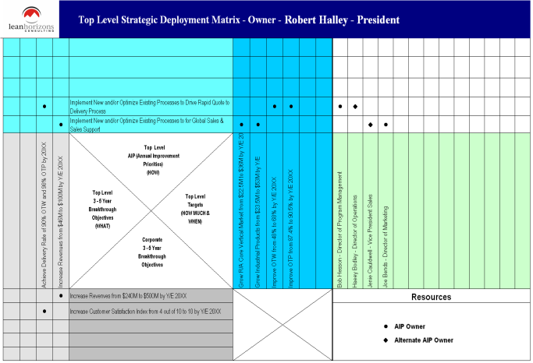
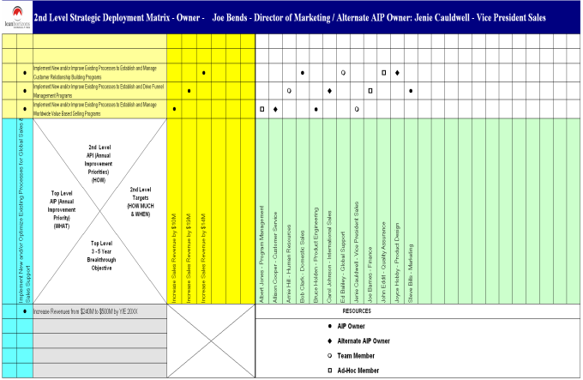
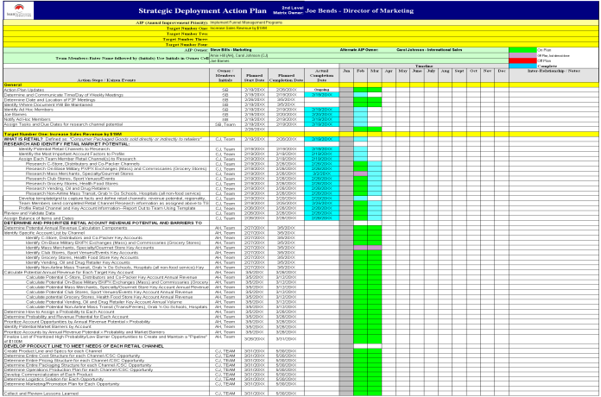
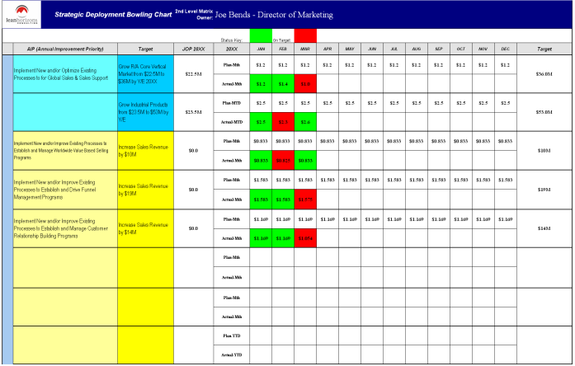
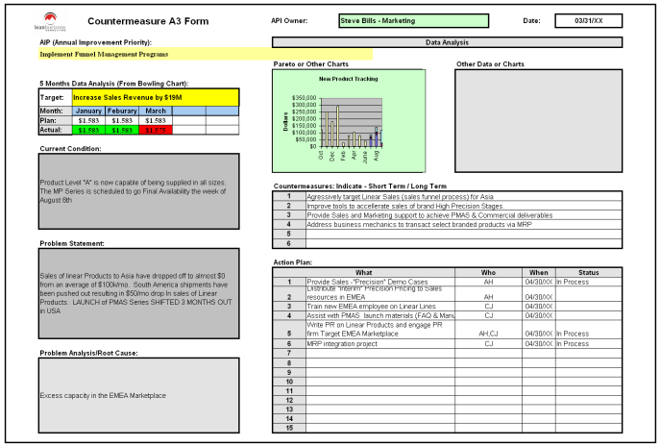
Strategic Deployment from Top Level Matrix to Countermeasures
Overview of Strategic Deployment
Top Level Matrix
Second Level Matrix
Action Plans
Bowling Chart
Countermeasure Form

Slide 21
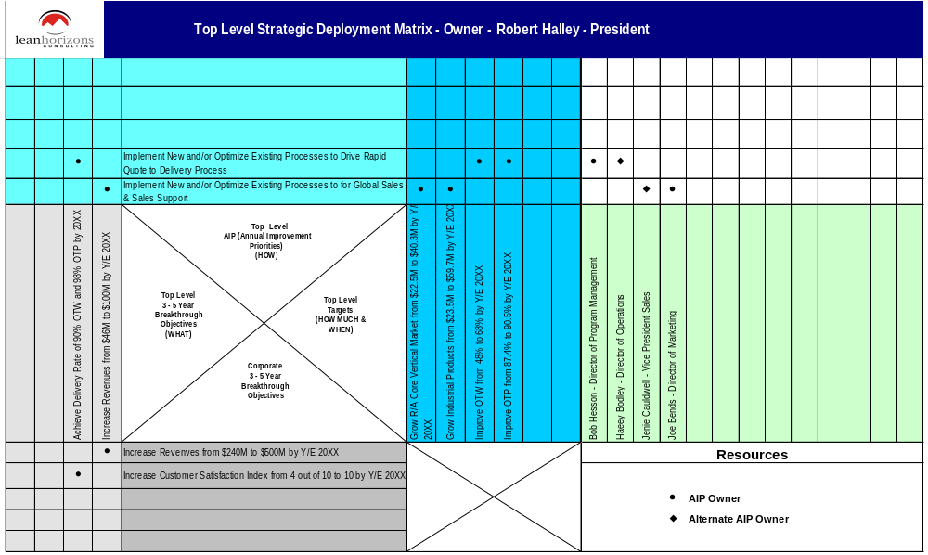
Strategic Deployment Top Level Matrix
Overview of Strategic Deployment
2
3
4
1
0

Slide 22

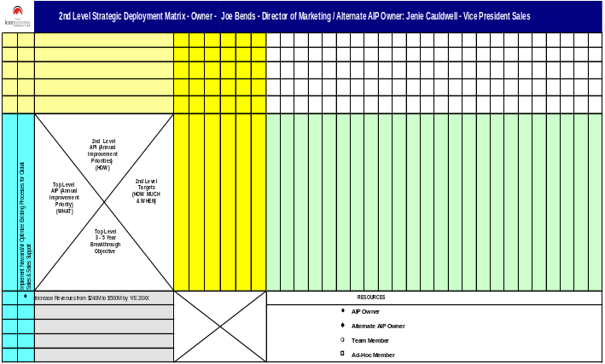
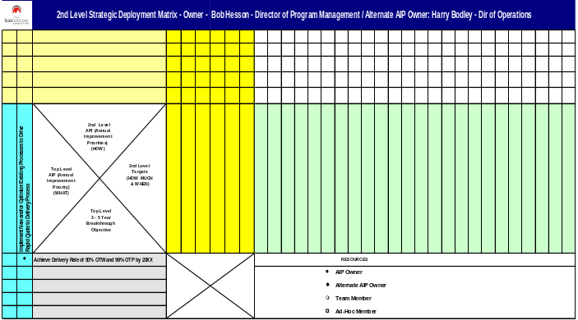
Cascading to Second Level
Overview of Strategic Deployment
Top Level Matrix
Second Level Matrix - Growth
4
2
3
5
6
2
1
1
Second Level Matrix - Delivery
4
2
5
6
1

Slide 23
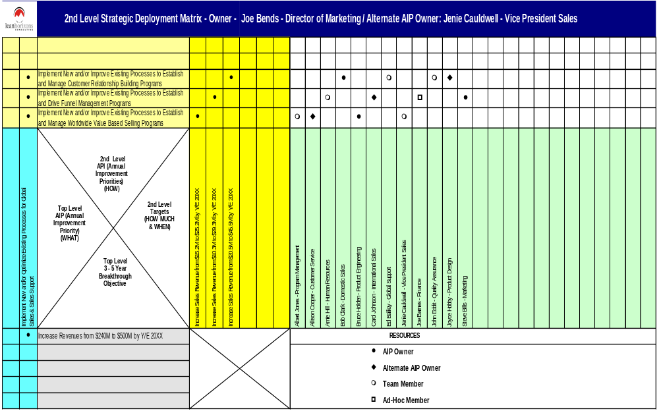
Second Level Matrix - Growth
Overview of Strategic Deployment
3
5
2
4
1

Slide 24

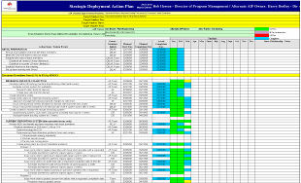

Action Plans for Each Second Level Improvement Priority
Overview of Strategic Deployment
Top Level Matrix
Action Plans
4
Second Level Matrix
4
4
4

Slide 25



Bowling Charts at Top and Second Level
Overview of Strategic Deployment
2
3
Top Level Matrix
Bowling Chart
1
2
3
4
5
4
Second Level Matrix - Growth
5
2
1

Slide 26




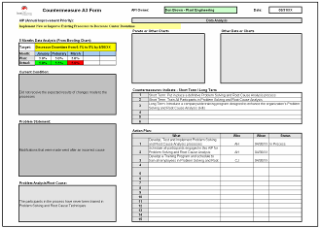
Countermeasures for Every Miss
Overview of Strategic Deployment
Countermeasure Form
Top Level Matrix
Second Level Matrix
Bowling Chart

Slide 27
Strategic Deployment - The Way To Run Your Business!
Overview of Strategic Deployment
Top Level Matrix
Second Level Matrix
Action Plans
Bowling Chart
Countermeasure Form

Slide 28
Breakthrough Objectives
Overview of Strategic Deployment
Components of Top Level Matrix
Creating the Top Level Matrix
Reflection
Objectives:
To define Breakthrough
To review concept of “stretch”/benchmarking
To emphasize concept of “aligning the organization to the vital few”
To discuss difference between Breakthrough and Continuous Improvement
To review examples of Breakthrough
To identify Breakthrough Objectives for Alpha Beta Case Study
Notes:
DO: Review section objectives on slide.

Slide 29
7 Phases of the Strategy Deployment Process
Based on the Deming Cycle - PDCA
Breakthrough Objectives
Develop Strategy
Plan
Develop Breakthrough Objectives
Catchball
Do
Check
Act
Develop AIPs, Targets, Resources
Deploy AIPs
Targeted
CI Efforts
Counter-
measures
Implement AIPs
Monthly PDCA Review
Annual Review
Notes:
SAY: “Here is where we are in the Strategic Deployment process.”

Slide 30
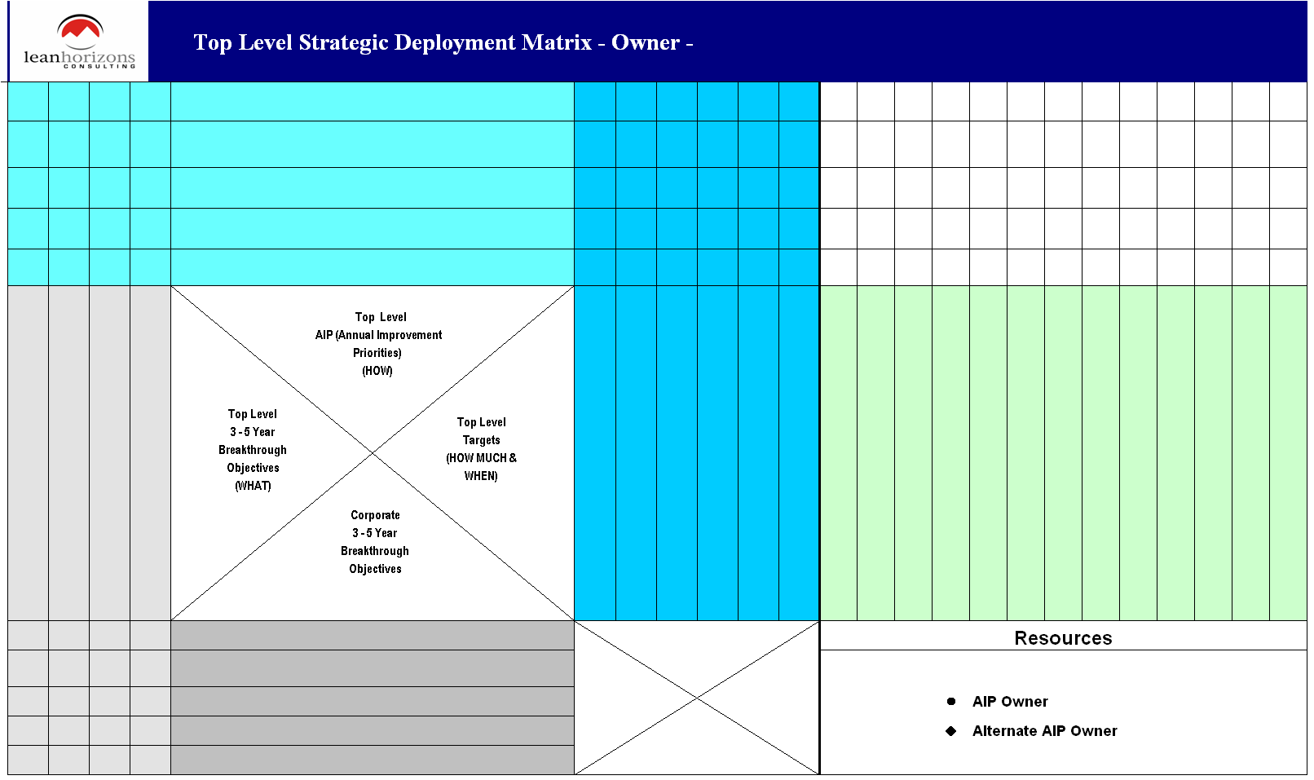
Breakthrough Objectives
Breakthrough Objectives
WHAT
Notes:
NOTE: This is the first time the matrix has been introduced. As a facilitator, you should build this matrix on the computer as the teams develop their BO’s, AIP’s, Targets and Resources.
DO: Take the group through the matrix, starting with BO’s, then AIP’s, targets and resources.
Stress that this is NOT a form-filling exercise.
Point out that the AIP’s (and not the targets) will eventually cascade to lower levels, deployed to cross-functional teams. You will address the mechanics of this later.

Slide 31
Breakthrough Objectives Defined
Breakthrough Objectives
Definition
Purpose
Length
Align with a business’ strategic imperatives
Represent a significant performance improvement
Require the organization to stretch itself to reach sustainable levels of performance never attained before
Focus the entire organization and its resources to the strategic few imperatives
Enable the business to profitably grow and compete and win in the marketplace
Are typically 3 – 5 year objectives
Breakthrough Objectives align the organization to the critical few.
Notes:
NOTE: This is the first time the matrix has been introduced. As a facilitator, you should build this matrix on the computer as the teams develop their BO’s, AIP’s, Targets and Resources.
DO: Take the group through the matrix, starting with BO’s, then AIP’s, targets and resources.
Stress that this is NOT a form-filling exercise.
Point out that the AIP’s (and not the targets) will eventually cascade to lower levels, deployed to cross-functional teams. You will address the mechanics of this later.

Slide 32
Breakthroughs vs. Business Fundamentals
Breakthrough Objectives
Consist of specifically defined actions targeted to achieve ultimate breakthrough |  | Consist of routine, day-to-day activities
Usually require a cross- functional team to accomplish |  | Have limited cross- functional interface
Process to achieve is unknown today |  | Have a standard usually in place
Monitored through Targets to Improve |  | Monitored through Key Performance Indicators (KPIs)
Achieve significant sustainable levels of improvement in 3 – 5 years |  | Achieve small scale improvements over time
Notes:
DO: Compare and contrast Breakthroughs from Business Fundamentals.
SAY: “As we said earlier, for some businesses, Business Fundamentals might actually be breakthrough for them, and where they need to focus first.”

Slide 33
Targeting Your Breakthroughs
Breakthrough Objectives
PERFECTION
IN 3–5 YEARS
Meaningful
Breakthroughs
WORLD CLASS
TODAY
Acceptable
Meaningful
Breakthroughs
BEST-IN-CLASS
Acceptable
INDUSTRY AVERAGE
Not Acceptable
Not Acceptable
Notes:
SAY: “A common mistake companies make is to focus on best-in-class results. Breakthrough Objectives need to be working on achieving world-class performance.
DO: Stress that we should not be benchmarking ourselves solely on our competition or industry, that we need to look beyond.
What we might deem acceptable today may not be acceptable in 3-5 years.
ASK: “Would we rather follow or lead?”

Slide 34
Breakthrough versus Continuous Improvement
Breakthrough Objectives
Strategic Objective is Achieved!!
Breakthrough
Business
Fundamentals
Kaizen (Continuous
Improvement)
Activities
Breakthrough
Business
Fundamentals
Improvement
Kaizen (Continuous
Improvement)
Activities
Breakthrough
Business
Fundamentals
Kaizen (Continuous
Improvement)
Activities
Business
Fundamentals
Business
Fundamentals
Year 0
Year 1
Year 2
Year 3
Year 4
Notes:
DO: Introduce the concept of Business Fundamentals, and that we are trying to build a company where the business fundamentals CONSISTENTLY achieve a high level of performance.
SAY: “This is not a one-time occurrence, rather it is a journey that never ends.
Typically kaizen gives us incremental levels of improvement, where SD gives us breakthrough improvement in performance.
Note that SD works on creating or re-defining our business processes. Once the new business process becomes institutionalized it becomes part of our Daily Management.
ASK: “In the spirit of continuous improvement, what do you think happens after year 4?” (do we stop? – no continuous improvement is never ending.)

Slide 35

How High Is Breakthrough?
Breakthrough Objectives
What are some Breakthroughs
you have seen in your lifetime?
_____________________
_____________________
_____________________
_____________________
_____________________
“I believe this nation should challenge itself to put a man on the moon, and return him safely to earth by the end of this decade.”
- John F. Kennedy, 1961
Notes:
DO: Ask the class why they would consider this a breakthrough (even though this was set at longer than 1-3 years …)
Potential answers:
At the time we didn’t know how to do it
It was clearly a stretch goal
It involved multifunctional support to achieve
Resulted in technologies that pushed the US forward significantly

Slide 36
Breakthrough Examples
Breakthrough Objectives
Financial
Achieve upper quartile financial performance as compared to peer companies from $X EBITA to $Y EBITA by FY20XX
Achieve RONA from X% to Y% by 11/30/XX
Generate cash flow from 0.7% to 1.2% of earnings by FY20XX
Strategic and Growth
Examples
Strategic/Market Growth
Improve revenue from Systems Sales from $X to $Y by 9/30/XX
Achieve market share in Motion Controls Market from 28% to 60% by FY20XX
Operational
Reduce internal quality rejects from 85,000 parts per million to 2,000 parts per million by 10/31/XX
Improve Customer Satisfaction index from 60 to 98 by FY20XX

Slide 37
Breakthrough Examples
Breakthrough Objectives
Financial
Increase inventory turns from 5 to 15 by 11/30/XX
Increase Operating Profit from 15% to 30% by FY20XX
Increase revenue from $100M to $175M by FY20XX
Business Fundamental
Examples
Operational
Improve OTD from 81% to 98% by 9/30/XX
Improve new product introduction from 11 months to 2 months by FY20XX
Reduce cost of goods manufactured from $X to $Y by FY20XX
Reduce Employee Accident Rate from 30 per year to 2 per year by 10/31/XX

Slide 38

Breakthrough Objectives… Your personal challenge!
Breakthrough Objectives
Top Mgt.
Breakthrough
Middle Mgt.
Kaizen
(Continuous
Improvement)
Supervisor
Business
Fundamentals
Front Line
Associate
How would this chart look for your business?
Notes:
DO: Remind the participants what is meant by “kaizen” (just in case).
ASK: “What is this chart telling you?”
SAY: “Key points to consider:
We want senior management to spend most of their time on strategic breakthroughs, NOT on daily management.
Kaizening daily management is critical if we are to free up our time to work on breakthrough.
Note that Front Line associates spend more of their time executing the work (working IN the business) within existing daily management processes.”

Slide 39
From Strategic Deployment to Kaizen (Continuous Improvement)
Breakthrough Objectives
Strategy
Case Study: OEM Manufacturer
Strategy: Achieve Market Share Objectives by becoming counter-cyclical
3-Year Breakthrough: Penetrate the Asian Marketplace to achieve $X of revenue
AIP: Implement New and/or Improve New Product Development Processes
Target: Achieve time-to-market improvement from
72 months to 18 months by XX/XX/XX
Value Stream Focus: Engine Lab Lead Time
Kaizen: Reduce changeover on test engine from 3 weeks to 1 day; Tool: SMED
3-Year Breakthrough
Objective
Annual Improvement
Priority/Target
Value Stream Focus
Kaizen
(Continuous Improvement)
Notes:
DO: Highlight the example of a breakthrough.

Slide 40
Breakthrough Objectives Checklist
Breakthrough Objectives
Are the Breakthrough Objectives….
Significant benefits to the organization?
Tied to strategy?
Customer-focused?
Stretch goals?
Enlisting cross-functional involvement?
Resulting in a new system or new way of doing business?
Not already learned? (Do we already know how to do it?)
Notes:
NOTE: You may not have a “yes” answer for each of these – but you should for most to qualify an objective as breakthrough.

Slide 41
Affinity Ground Rules for Breakthrough Objectives
Breakthrough Objectives
Silent brainstorming…no discussion during Post-it writing exercise
At least 2 quality Breakthrough Objective Post-its per person
Everyone’s ideas are treated equally
One idea (Breakthrough Objective) per Post-it
Write name on the top of Post-it
Be clear; state Breakthrough Objective in the form of a breakthrough:
  Wrong: Grow the business
  Right: Increase revenue from $275M to $500M by 12/31/XX
Focus on the critical few ideas that are based on the Business Case analysis

Slide 42
Affinity Process for Breakthrough Objectives
Breakthrough Objectives
Step 1: Each participant silently brainstorms 2 Breakthrough Objectives
Write each Breakthrough on a Post-it note
Step 2: Each participant individually shares Post-it notes aloud and then posts on board/flipchart
No judgments are cast yet about what is posted
Step 3: Company leader facilitates the grouping of like ideas
Each grouping must be given a title or category name
Notes:
NOTE: This slide animates to show the facilitation process for creating breakthrough objectives.

Slide 43

Affinity Process for Breakthrough Objectives
Breakthrough Objectives
Step 4: Using the Breakthrough Analysis Tool, Company Leader or SD Facilitator facilitates the “down-selection” process from X+ ideas to the top Breakthrough Objectives for the business
Step 5: Transfer Breakthrough Objectives to the Top Level Matrix
Notes:
NOTE: This slide animates to show the facilitation process for creating breakthrough objectives.

Slide 44
Exercise: Alpha Beta Case Study
Breakthrough Objectives
Objective
Determine Breakthrough Objectives for Alpha Beta Case Study
Instructions
Time to Complete
Using the information from the Alpha Beta Company Case Study determine the 3–4 Breakthrough Objectives
Use the checklist as a reference.
45 minutes
Deliverable
3–4 Breakthrough Objectives for Alpha Beta Company
Notes:
NOTE: Use the same affinity process the team will later use to create their own Breakthrough objectives (see section on “Creating The Top Level Matrix”. This exercise can be done as a class.

Slide 45
Creating Annual Improvement Priorities (AIPs)
Overview of Strategic Deployment
Components of Top Level Matrix
Creating the Top Level Matrix
Reflection
Objectives:
To define Annual Improvement Priority
To review positive and negative examples of process improvements
To review examples from Lean Horizons
To develop Annual Improvement Priorities for each Breakthrough Objective for Alpha Beta Case Study
Notes:
DO: Review section objectives on slide.

Slide 46
7 Phases of the Strategy Deployment Process
Based on the Deming Cycle - PDCA
Annual Improvement Priorities
Develop Strategy
Plan
Develop Breakthrough Objectives
Catchball
Do
Check
Act
Develop AIPs, Targets, Resources
Deploy AIPs
Targeted
CI Efforts
Counter-
measures
Implement AIPs
Monthly PDCA Review
Annual Review
Notes:
SAY: “Here is where we are in the Strategic Deployment process.”

Slide 47
Annual Improvement Priorities
Annual Improvement Priorities
HOW
WHAT
Notes:
SAY: “Here is where our Annual Improvement Priorities will be inputted on the matrix.”

Slide 48
Annual Improvement Priorities Defined
Annual Improvement Priorities
Definition
Purpose
Examples
A business-process-based transformation required to enable a sustained breakthrough in business performance
Ensure that actions performed to achieve the overall breakthrough are designed with process in mind
Key is sustainable – not a “one-time” achievement of the breakthrough
Design and Implement a Talent Mgmt. System
Design and Implement a Sales and Operations Planning Process
Define and implement a Rationalized Distribution Network
Implement an improved NPD Process
Annual Improvement Priorities focus on the PROCESS
Notes:
DO: Read the definition, and ask the class for examples of annual improvement priorities in their own companies.

Slide 49
Rate the Annual Improvement Priorities
Annual Improvement Priorities
AIP Example | Good Example | Poor Example
Improve Productivity
Fully Develop and Implement a New Product Development Process
Improve Material Costs
Develop Acquisition Integration Process
Develop XXX Market
Improve On-time Delivery
Notes:
DO: Ask the class why these are good/bad examples of AIP’s.
ANSWERS:
Improve Productivity: Not a process. Ask the class what is the process? It is more like a measure without the specific numerical targets.
Fully Develop and Implement a New Product Development Process: A good example of a process-based AIP. Point out that this is working ON the business.
Improve Material Costs: See explanation of “Improve Productivity”.
Develop Acquisition Process: A good example of a processed-based AIP. This could be a good example of an AIP that supports a growth BO.
Develop Life Science Market: This initiative is a good example of an AIP that will support growth BO’s.
Improve On-Time Delivery: See explanation of “Improve Productivity”.

Slide 50
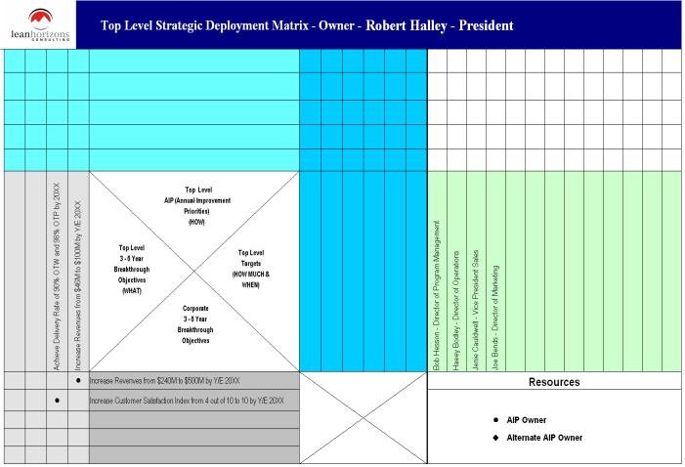
Where do AIPs Come From?
Annual Improvement Priorities
Strategic
Plans and
Imperatives
High
Lean and
Operational
Assessments
Complexity
“Backburner”
“Breakthrough”
Customer
Assessments
And Feedback
“Just Do it”
“Business Fundamentals”
Benchmarking &
Technological
Trends
Low
Low
Impact / Value
High
Deciding what NOT to do
is Harder than deciding WHAT to do!
Notes:
SAY: “Note that there are several inputs that will help us develop our AIP’s. Some of these are listed above. Do not limit yourself to these inputs.
The idea behind the Pareto chart is that we will come up with many possible AIP’s, but they need to be prioritized as to their impact on the Breakthrough Objective. Remember, you must stress that the organization needs to be focused and cannot do everything, so there needs to be an objective way to determine which AIP’s will be worked on, and which will not.
Keep in mind that just because an AIP was not selected does not mean that it will not be selected some time in the future. Again, what we are looking for is those AIP’s that will have the most impact TODAY.”

Slide 51
AIP Checklist
Annual Improvement Priorities
Are the Annual Improvement Priorities…
Tied to the established Breakthrough Objectives?
Supporting opportunities listed in the SWOT analysis?
Process-focused?
Customer-focused?
Measurable?
Enlisting cross-functional involvement?
Representing significant improvements?
Resulting in a new system or new way of doing business?
Not already learned? (Do we already know how to do it?)
Notes:
NOTE: You may not have a “yes” answer for each of these – but you should for most to qualify as an AIP.

Slide 52
Use Affinity Process as shown in earlier slides - Ground Rules for AIPs
Annual Improvement Priorities
Silent brainstorming…no discussion during Post-it writing exercise
At least 2 quality AIP Post-its per AIP
Everyone’s ideas are treated equally
One idea (AIP) per Post-it
Write name on the top of Post-it
Be clear; state the AIP in the form of a process:
  Wrong: Improve Material Costs
  Right: Implement new and/or optimize existing Supplier Certification Processes
Focus on the critical few ideas based on the Breakthrough Objectives

Slide 53
Exercise: Alpha Beta Case Study
Annual Improvement Priorities
Objective
Determine Top Level AIPs for Alpha Beta Case Study
Instructions
Time to Complete
Using information from the case study,
determine the Top Level AIPs that tie to the
Breakthrough Objectives for the Alpha Beta Company
45 minutes
Deliverable
1–2 AIPs for each Breakthrough
Objective for Alpha Beta Company
Notes:
NOTE: Use the same affinity process the team will later use to create their own AIPs (see section on “Creating The Top Level Matrix”. This exercise can be done as a class, or if it is a large group, you can break them into smaller groups to complete.
DO: Have one “master” matrix that gets completed on chart paper on the wall at the end of each of these exercises so that the class can see how the matrix is built.

Slide 54
Developing Targets
Overview of Strategic Deployment
Components of Top Level Matrix
Creating the Top Level Matrix
Reflection
Objectives:
To define “Target”
To review the anatomy of a Target
To identify positive and negative examples of Targets
To develop Targets for each AIP for Alpha Beta Case Study
Notes:
DO: Review section objectives on slide.

Slide 55
Targets
Targets
HOW
WHAT
HOW MUCH/
BY WHEN
Notes:
SAY: “Here is where the Targets will be inputted on the matrix.”

Slide 56
Targets Defined
Targets
Definition
Characteristics
Examples
The quantitative measure of the effectiveness of a given Annual Improvement Process
Quantitative not qualitative
Frequent enough (at least monthly)
Reference a time frame
Show a true cause-and-effect relationship with AIP
True stretch
Improve PPM rejects from 50,000 to 5,000 by 12/31/XX
Achieve productivity improvement from 10 units per associate to 18 units per associate by 9/30/XX
Must Show a True Cause and Effect Relationship to the Top Level AIP
Notes:
NOTE: Not all target dates should be the last day of the fiscal year. Determine the date that is appropriate to meeting the Breakthrough.

Slide 57
Anatomy of Targets
Targets
VERB | NOUN | FROM X TO Y | BY | DATE
Improve | Inventory Turns | From 5.0 to 10.0 | BY | 12/31/XX
Notes:
DO: Give the class an example AIP and have them write 2 targets to improve on the lines provided:
Example: let’s say you had a Breakthrough Objective of ‘Eliminate 100% Credit Card Debt’ and one of the AIPs was to ‘Implement a Monthly Household Budget Process’. What would be 1-2 targets that could measure the effectiveness of this AIP?

Slide 58
Rate the Targets
Targets
Target Example | Good Example | Poor Example
Reduce lead time in NPD from 36 months to 12 months by 12/31/XX
Improve internal quality
Perform 20 Kaizens by 12/31/XX
Increase Organic Revenue from New Systems Sales from $30M to $45M by 10/31/XX
Implement Standard Work in Accounts Payable
Improve Productivity from $20,000/Day to $30,000/Day by 12/31/XX
Notes:
DO: Ask the class why these are good/bad examples of Targets.
ANSWERS:
Note that some of the “Bad” examples are in fact AIP’s (Implement Standard Work in Accounts Payable”.
Some are not aggressive enough: “Achieve 4% productivity improvement”
Note that there is a format that a target should follow:
WHAT TO IMPROVE FROM/TO BY WHEN: Example: Improve PPM Rejects from 50,000 to 5,000 by 12/31/XX.

Slide 59
Target Checklist
Targets
Do/Are the Targets….
Measurable, at least monthly?
Quantifiable?
Time-bound?
Stretch for the organization?
Show a “from-to” range?
Support reaching the Breakthrough Objectives?
Involved development data that is easily attained?
Have a true cause-and-effect relationship with the AIP?
Notes:
NOTE: You may not have a “yes” answer for each of these – but you should for most to qualify as a target.

Slide 60
Use Affinity Process as shown in earlier slides - Ground Rules for Targets
Breakthrough Objectives
Silent brainstorming…no discussion during Post-it writing exercise
At least 2 quality Target Post-its per AIP
Everyone’s ideas are treated equally
One idea (Target) per Post-it
Write name on the top of Post-it
Be clear; state the Target as follows:
  Wrong: Decrease Quality Rejects by 25k
  Right: Decrease Quality Rejects from 45k PPM to 20k PPM by 12/31/XX

Slide 61
Exercise: Alpha Beta Case Study
Targets
Objective
Develop Targets for Alpha Beta Case Study
Instructions
Time to Complete
Develop Top Level Targets that measure the
effectiveness of the AIPs for the Alpha Beta Company
45 minutes
Deliverable
1–2 Targets for each AIP for Alpha Beta Company
Notes:
NOTE: Use the same process the team will later use to create their own Targets (see section on “Creating The Top Level Matrix”. This exercise can be done as a class, or if it is a large group, you can break them into smaller groups to complete.
DO: Have one “master” matrix that gets completed on chart paper on the wall at the end of each of these exercises so that the class can see how the matrix is built.

Slide 62
Establishing Resources
Overview of Strategic Deployment
Components of Top Level Matrix
Creating the Top Level Matrix
Reflection
Objectives:
To review general guidelines for establishing resources
To define team composition
To identify lead and supporting resources for each AIP for Alpha Beta Case Study
Notes:
DO: Review section objectives on slide.

Slide 63
Establishing Resources
Resources
HOW
WHAT
HOW MUCH/
BY WHEN
WHO
Notes:
SAY: “Here is where the Resources will be inputted on the matrix.”

Slide 64
Establish Resources – Guidelines
Resources
As a rule, each AIP needs to have one primary resource assigned as an AIP Owner and an Alternate AIP Owner should the primary resource not be available due to vacations, illness, etc.
The following symbols are used to designate:
l Primary Resource – AIP Owner
  Has Full Responsibility Implementing the AIP
      Assuring Sustainable Processes are Created
      Assuring the Business Results are Achieved
u Alternate AIP Owner (Optional)
    Is Assigned the Responsibility as AIP Owner when the Primary Resource / AIP Owner is Not Available to Conduct Meetings, etc.
  AIP Owners and the Alternate AIP Owners cascade to the next level.
Notes:
SAY: “Note that just because someone gets assigned as a Secondary resource, this does not mean that they are any less responsible for implementing the AIP.”
SAY: “Note that most breakthrough AIP’s are cross-functional in nature and need to have a cross-functional team assigned.”

Slide 65
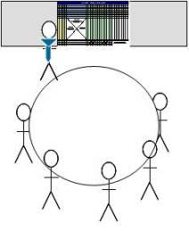
Process for Developing Cross-functional Teams for each AIP
Resources
Group exercise…all will participate.
Determine AIP Owners (Black Dot).
Determine Alternate AIP Owners (Black Diamond), (Optional).
Perform sanity check as to resource loads, etc.
Insert the names and titles of AIP Owners and Alternate AIP Owners for each AIP into Matrix.

Slide 66
Creating Your Breakthrough Objectives, AIPs, Targets and Determining Resources
Creating the Top Level Matrix
    Brainstorm and Determine Breakthrough Objectives
Brainstorm and Determine Annual Improvement Priorities (AIPs)
Brainstorm and Determine Targets to Improve
Brainstorm and Determine Resources for each AIP

Slide 67
Creating the Top Level Matrix
Creating the Top Level Matrix
    Brainstorm and Determine Breakthrough Objectives
Brainstorm and Determine Annual Improvement Priorities (AIPs)
Brainstorm and Determine Targets to Improve
Brainstorm and Determine Resources for each AIP

Slide 68
Breakthrough Objectives Checklist
Creating the Top Level Matrix
Are the Breakthrough Objectives…
Significant benefits to the organization?
Tied to strategy?
Customer-focused?
Stretch goals?
Enlisting cross-functional involvement?
Resulting in a new system or new way of doing business?
Not already learned? (Do we already know how to do it?)
Notes:
NOTE: You may not have a “yes” answer for each of these – but you should for most to qualify an objective as breakthrough.

Slide 69
Breakthrough Examples
Creating the Top Level Matrix
Financial
Achieve upper quartile financial performance as compared to peer companies from $X EBITA to $Y EBITA by FY20XX
Achieve RONA from X% to Y% by 11/30/XX
Generate cash flow from 0.7% to 1.2% of earnings by FY20XX
Strategic and Growth
Examples
Strategic/Market Growth
Improve revenue from Systems Sales from $X to $Y by 9/30/XX
Achieve market share in Motion Controls Market from 28% to 60% by FY20XX
Operational
Reduce internal quality rejects from 85,000 parts per million to 2,000 parts per million by 10/31/XX
Improve Customer Satisfaction index from 60 to 98 by FY20XX

Slide 70
Breakthrough Examples
Creating the Top Level Matrix
Financial
Increase inventory turns from 5 to 15 by 11/30/XX
Increase Operating Profit from 15% to 30% by FY20XX
Increase revenue from $100M to $175M by FY20XX
Business Fundamental
Examples
Operational
Improve OTD from 81% to 98% by 9/30/XX
Improve new product introduction from 11 months to 2 months by FY20XX
Reduce cost of goods manufactured from $X to $Y by FY20XX
Reduce Employee Accident Rate from 30 per year to 2 per year by 10/31/XX

Slide 71
Use Affinity Process as shown in earlier slides -Ground Rules for Breakthrough Objectives
Creating the Top Level Matrix
Silent brainstorming…no discussion during Post-it writing exercise
At least 2 quality Breakthrough Objectives per person
Everyone’s ideas are treated equally
One idea (Breakthrough Objective) per Post-it
Write name on the top of Post-it
Be clear; state Breakthrough Objective in the form of a breakthrough:
  Wrong: Grow the business
  Right: Increase revenue from $275M to $500M by 12/31/XX
Focus on the critical few ideas that are based on the Business Case analysis

Slide 72
Breakthrough Analysis Tool
Creating the Top Level Matrix
PROPOSED BREAKTHROUGH | RELEVANCE TO SWOT | IMPACT ON $$ | IMPACT ON CUSTOMER | OVERALL SCORE
 | H, M, L | H, M, L | H, M, L
 | H, M, L | H, M, L | H, M, L
 | H, M, L | H, M, L | H, M, L
 | H, M, L | H, M, L | H, M, L
 | H, M, L | H, M, L | H, M, L
 | H, M, L | H, M, L | H, M, L
List
proposed
Breakthrough
Objectives
here and rank
High, Medium,
or Low against
criteria.
Use this
tool and
discussion
to
down-select
to top 3 – 4

Slide 73
Your Turn: Create Breakthrough Objectives
Creating the Top Level Matrix
Objective
Create Breakthrough Objectives for your company
Instructions
Time to Complete
Following the Affinity Process outlined on the
previous slides, as a team, brainstorm the top
three to four 3–5 Year Breakthrough Objectives for your company.
Company leader and SD Facilitator facilitate this process.
1 ½ hours
Deliverable
Reach consensus on top three to four Breakthrough Objectives for your company
Notes:
NOTE: Now the team will stop and create their breakthrough objectives. It is important the company leader is leading/facilitating this session. As the consultant, provide facilitation guidance as needed.
NOTE: Times may vary.

Slide 74
Creating the Top Level Matrix
Creating the Top Level Matrix
    Brainstorm and Determine Breakthrough Objectives
Brainstorm and Determine Annual Improvement Priorities (AIPs)
Brainstorm and Determine Targets to Improve
Brainstorm and Determine Resources for each AIP

Slide 75
Reviewing Annual Improvement Priorities
Creating the Top Level Matrix
Are the Annual Improvement Priorities…
Tied to the established Breakthrough Objectives?
Supporting opportunities listed in the SWOT analysis?
Process-focused?
Customer-focused?
Measurable?
Enlisting cross-functional involvement?
Representing significant improvements?
Resulting in a new system or new way of doing business?
Not already learned? (Do we already know how to do it?)
Notes:
NOTE: You may not have a “yes” answer for each of these – but you should for most to qualify as an AIP.

Slide 76
Reviewing Annual Improvement Priority Examples
Creating the Top Level Matrix
Operational-focused
Growth-focused
Implement new and/or optimize existing Sales & Operations Planning Processes
Implement new and/or improve Supplier Certification Processes
Implement new “Pull” Production System
Implement a Lean Distribution Network
Implement new and/or optimize existing Market Opportunity Assessment Processes
Implement new and/or reengineer existing Product Development Processes
Implement new and/or improve existing “Voice of the Customer” Processes

Slide 77
Use Affinity Process as shown in earlier slides - Ground Rules for AIPs
Creating the Top Level Matrix
Silent brainstorming…no discussion during Post-it writing exercise
At least 2 quality AIP’s per Breakthrough Objective, per person
Everyone’s ideas are treated equally
One idea (AIP) per Post-it
Write name on the top of Post-it
Be clear; state the AIP in the form of a process:
  Wrong: Improve Material Costs
  Right: Implement new and/or optimize existing Supplier Certification Processes
Focus on the critical few ideas based on the Breakthrough Objectives

Slide 78
Your Turn: Create Annual Improvement Priorities
Creating the Top Level Matrix
Objective
Create Annual Improvement Priorities for your company
Instructions
Time to Complete
Following the Affinity Process outlined on the
previous slides, as a team, brainstorm the top
Annual Improvement Priorities that drive to the
Breakthrough Objectives for your company.
Company leader and SD Facilitator facilitate this process.
2-3 hours
Deliverable
Reach consensus on top 1-2 AIPs for each Breakthrough Objective for your company
Notes:
NOTE: Times may vary.

Slide 79
AIP Priority Filter
Creating the Top Level Matrix
High
“Backburner”
“Breakthrough”
Complexity
“Just Do It”
“Business Fundamentals”
Low
Low
Impact / Value
High

Slide 80
Creating the Top Level Matrix
Creating the Top Level Matrix
    Brainstorm and Determine Breakthrough Objectives
Brainstorm and Determine Annual Improvement Priorities (AIPs)
Brainstorm and Determine Targets to Improve
Brainstorm and Determine Resources for each AIP

Slide 81
Target Checklist
Creating the Top Level Matrix
Are the Targets….
Measurable, at least monthly?
Quantifiable?
Time-bound?
Stretch for the organization?
Show a “from-to” range?
Support reaching the Breakthrough Objectives?
Involved development data that is easily attained?
Have a true cause-and-effect relationship with the AIP?
Notes:
NOTE: You may not have a “yes” answer for each of these – but you should for most to qualify as a target.

Slide 82
Anatomy of Targets
Creating the Top Level Matrix
VERB | NOUN | FROM X TO Y | BY | DATE
Improve | Inventory Turns | From 5.0 to 10.0 | BY | 12/31/XX
Notes:
DO: Review the anatomy of a target.

Slide 83
Use Affinity Process as shown in earlier slides - Ground Rules for Targets
Creating the Top Level Matrix
Silent brainstorming…no discussion during Post-it writing exercise
At least 2 quality Targets per AIP, per person
Everyone’s ideas are treated equally
One idea (Target) per Post-it
Write name on the top of Post-it
Be clear; state the Target as follows:
  Wrong: Decrease Quality Rejects by 25k
  Right: Decrease Quality Rejects from 45k PPM to 20k PPM by 12/31/XX

Slide 84
Your Turn: Create Targets
Creating the Top Level Matrix
Objective
Develop targets that measure AIP effectiveness for your company
Instructions
Time to Complete
Following the Affinity Process outlined on the
previous slides, break into small groups and
develop the top level targets for each AIP.
Company leader and SD Facilitator
facilitate this process.
1-2 hours
Deliverable
Reach consensus on top 1-2 top level targets for each AIP for your company
Notes:
NOTE: Times may vary.

Slide 85
Creating the Top Level Matrix
Creating the Top Level Matrix
    Brainstorm and Determine Breakthrough Objectives
Brainstorm and Determine Annual Improvement Priorities (AIPs)
Brainstorm and Determine Targets to Improve
Brainstorm and Determine Resources for each AIP

Slide 86
Establish Resources – Guidelines
Creating the Top Level Matrix
As a rule, each AIP needs to have one primary resource assigned as an AIP Owner and an Alternate AIP Owner should the primary resource not be available due to vacations, illness, etc.
The following symbols are used to designate:
l Primary Resource – AIP Owner
  Has Full Responsibility Implementing the AIP
      Assuring Sustainable Processes are Created
      Assuring the Business Results are Achieved
u Alternate AIP Owner (Optional)
    Is Assigned the Responsibility as AIP Owner when the Primary Resource / AIP Owner is Not Available to Conduct Meetings, etc.
  AIP Owners and the Alternate AIP Owners cascade to the next level.
Notes:
SAY: “Note that just because someone gets assigned as a Secondary resource, this does not mean that they are any less responsible for implementing the AIP.”
SAY: “Note that most breakthrough AIP’s are cross-functional in nature and need to have a cross-functional team assigned.”

Slide 87
Team Composition Considerations
Creating the Top Level Matrix
Ability to work in cross-functional environment
Level of experience within role/organization
Capabilities and Competencies
Type of work to be performed
Geographical location
Current workload constraints
Level within the organization
Prior role as team leader/participant
“Charger”
Working type
  Doer
  Thinker
  Director
  Follower

Slide 88
Process for Developing Cross-functional Teams for each AIP
Creating the Top Level Matrix
Group exercise…all will participate.
Determine AIP Owners (Black Dot).
Determine Alternate AIP Owners (Black Diamond), (Optional).
Perform sanity check as to resource loads, etc.
Insert the names and titles of AIP Owners and Alternate AIP Owners for each AIP into Matrix.

Slide 89
Your Turn: Establish Resources
Creating the Top Level Matrix
Objective
Establish resources to support each AIP for your company
Instructions
Time to Complete
As a group, determine the AIP Owner (Black Dot) and Alternate AIP Owner (Optional) (Black Diamond) to support each AIP.
30-60 minutes
Deliverable
Reach a consensus on the resources for ownership of each AIP for your company
Notes:
NOTE: Times may vary.

Slide 90
Create the Top Level Matrix
Creating the Top Level Matrix
Review a Sample Completed Top Level Matrix
Complete Top Level Matrix

Slide 91
Strategic Deployment Top Level Matrix
Creating the Top Level Matrix
2
3
4
1
0

Slide 92
Your Turn: Creating the Top Level Matrix
Creating the Top Level Matrix
Objective
Create the Top Level Matrix
Instructions
Time to Complete
After you have determined the Breakthrough
Objectives, AIPs, Targets and Resources Please
them in their respective areas in the Top Level
Matrix
1 hour
Deliverable
A completed Top Level Matrix for your Company
Notes:
NOTE: Times may vary.

Slide 93
Reflection on the Top Level Matrix
Overview of Strategic Deployment
Components of Top Level Matrix
Creating the Top Level Matrix
Reflection
Objectives:
To evaluate Top Level Matrix
To use the AIP Priority filter to prioritize and finalize AIPs moving forward
To gain consensus on the finalized Top Level Matrix
To determine data gaps and identify actions for closing data gaps beyond the event
Notes:
DO: Review section objectives on slide.

Slide 94
Reflection on the Top Level Matrix
Reflection
As a team, look at the completed Top Level Matrix.
Answer the following questions:
  Are the Breakthrough Objectives the correct Breakthrough Objectives?
  Do the AIPs support the respective Breakthrough Objective?
  Do we have too many AIPs?
  What other commitments are in conflict with SD plan? (generate vigorous discussion)
  Are there other initiatives and projects that need to be re-assessed?
  Is this organization comfortable working in a cross-functional environment?
Deliverable from this exercise is a personal action plan for every AIP Owner (Black Dot) to move forward with next steps.
Notes:
ASK: “What other commitments are in conflict with SD plan? (generate vigorous discussion)”
Table the right questions
Are there other initiatives and projects that need to be re-assessed?
Is this organization comfortable working in a cross-functional environment?

Slide 95
Your Turn: Reflecting on the Top Level Matrix
Reflection
Objective
Reflect on the Top Level Matrix and determine any changes
Instructions
Time to Complete
As a team, discuss the questions highlighted in
this section. Use the AIP filter again if necessary to further down-select to the critical AIPs.
All AIP Owners (Black Dot) complete the personal action plan on the following page of next steps to complete following this SD session.
30 minutes
Deliverable
Next step plan for every AIP Owner (Black Dot) to move forward with next steps

Slide 96
Next Step Plan
Reflection
What | Who | By When
Notes:
NOTE: This is the plan that corresponds with the exercise on the previous page.

Slide 97
Strategic Deployment - The Way To Run Your Business!
Reflection
Top Level Matrix
Second Level Matrix
Action Plans
Bowling Chart
Countermeasure Form

Slide 98
Success Factors for Developing and Driving an SD Culture
Reflection
Strong, hands-on leadership that evaluates progress monthly and demonstrates an on-going interest
Ensuring that SD has the Highest Level of Priority
Requiring the use of the appropriate tools (e.g., problem-solving tools) and root cause analysis
Management applying rigor and discipline to the SD process
Ensuring that the Strategic Deployment vision is understood at all levels in the organization and that the activities and results are continually communicated through the organization
Willingness to invest in Employee/Management development
Notes:
NOTE: Do not read this slide, however have the class review it and ask for each bullet point – what will it take to accomplish this?
DO: Ask if these success factors exist in their organization. Any gaps?

Slide 99
Summary
Reflection
Experience has proven that it takes an organization time to become “competent” in the Strategic Deployment methodology, however with rigorous application of Strategic Deployment, it has been proven that substantial value can be created immediately.
Resist the tendency to do Strategic Deployment “your way.” Follow the guidelines within. They are there for a reason.
Strategic Deployment Should Not be Viewed as Another Task…this Should Be the Way that You Run Your Business!!!
Insist on Data. How You Ask Questions Will Change the Culture!!!
Good things will come! Strategic Deployment makes very good Employees/Managers Great Employees/Managers
Notes:
DO: Wrap up an ask the participants if they have any additional questions.

Slide 100
Appendix
Strategic Deployment in 7 Slides
Danaher Slide
Other Modules within Lean Horizons’ Offerings

Slide 101
Strategic Deployment Top Level Matrix
2
3
4
1
0

Slide 102
Cascading to Second Level
Top Level Matrix
Second Level Matrix - Growth
4
2
3
5
6
2
1
1
Second Level Matrix - Delivery
4
2
5
6
1

Slide 103
Second Level Matrix - Growth
3
5
2
4
1

Slide 104
Action Plans for Each Second Level Improvement Priority
Top Level Matrix
Action Plans
4
Second Level Matrix
4
4
4

Slide 105
Bowling Charts at Top and Second Level
2
3
Top Level Matrix
Bowling Chart
1
2
3
4
5
4
Second Level Matrix - Growth
5
2
1

Slide 106
Countermeasures for Every Miss
Countermeasure Form
Top Level Matrix
Second Level Matrix
Bowling Chart

Slide 107
Strategic Deployment - The Way To Run Your Business!
Top Level Matrix
Second Level Matrix
Action Plans
Bowling Chart
Countermeasure Form

Slide 108
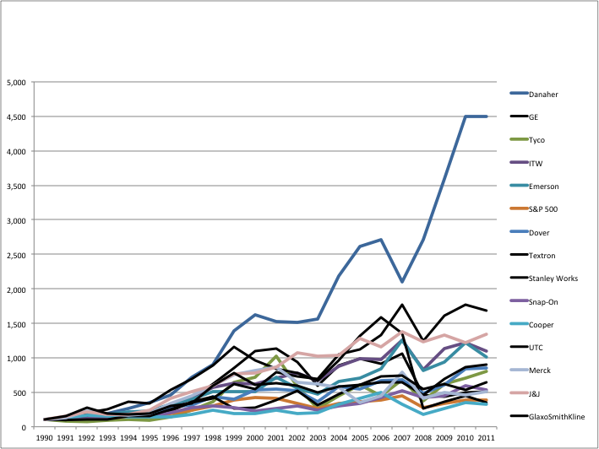
What Strategic Deployment Can Do For You
DHR: Steady Growth Valued by the “Street” $16.1 Billion Annual Revenues. An Investment of $100 in DHR stock on 12/31/1990 with dividends reinvested was worth $4,501 on 12/31/2011 compared to $382 for comparable S & P 500 Investment.

Slide 109

Other Modules In This Series:
5S
Standard Work
Total Productive Maintenance (TPM)
Administrative Lean
Cell Design/ Production Preparation Process (3P)
Kaizen
Kanban
Problem Solving
Poka Yoke Quality Systems
Transaction Process Improvement (TPI)
Cause & Effect Diagram with the Additions of Cards (CEDAC)
Single Minute Exchange of Dies (SMED)
Value Stream Mapping (VSMi®)
Visual Management
Managing Daily Process Excellence
For More Information Please Contact:
Mark DeLuzio, President and CEO
+1.860.234.0915
mark.deluzio@leanhorizons.com
Strategically Creating Value Through the Elimination of Waste

